Slide 1
Greedy Partial Knapsack, Greedy Huffman Coding

Slide 2
Knapsack Problem

Slide 3
Knapsack problem
A 1998 study of the Stony Brook University Algorithm Repository showed that, out of 75 algorithmic problems, the knapsack problem was the 18th most popular and the 4th most needed after kd-trees, suffix trees, and the bin packing problem

Slide 4
Knapsack Problem
Given a set of items, each with a mass and a value, determine the number of each item to include in a collection so that the total weight is less than or equal to a given limit and the total value is as large as possible.
It derives its name from the problem faced by someone who is constrained by a fixed-size knapsack and must fill it with the most valuable items.
Notes:
1. Items are indivisible: you either take an item or not. Solved with dynamic programming
2. Items are divisible: you can take any fraction of an item. Solved with a greedy algorithm

Slide 5
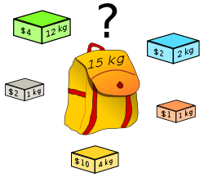
Knapsack Problem
which boxes should be chosen to maximize the amount of money while still keeping the overall weight under or equal to 15 kg?
Answer: 3 yellow boxes and 3 grey boxes
Notes:
1. Items are indivisible: you either take an item or not. Solved with dynamic programming
2. Items are divisible: you can take any fraction of an item. Solved with a greedy algorithm

Slide 6
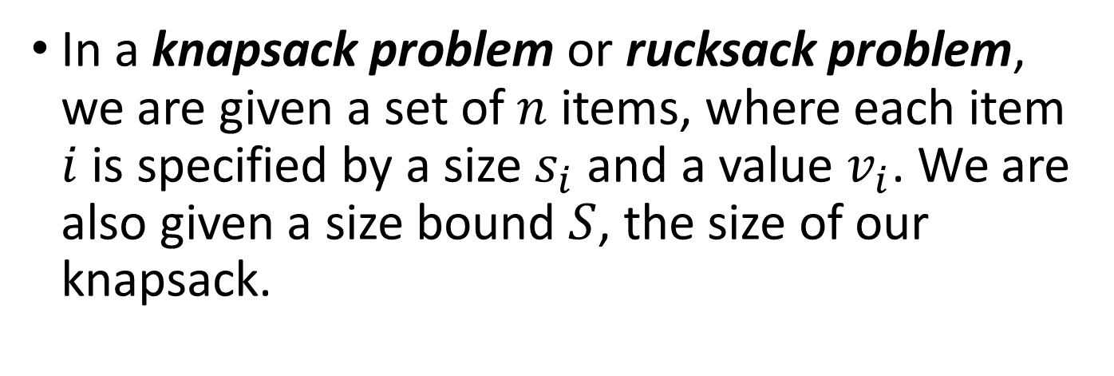
Knapsack Problem
In a knapsack problem or rucksack problem, we are given a set of $n$ items, where each item $i$ is specified by a size $s_{i}$ and a value $v_{i}$. We are also given a size bound $S$, the size of our knapsack.
Item # | Size | Value
1 | 1 | 8
2 | 3 | 6
3 | 5 | 5

Slide 7
Knapsack Problem
There are two versions of the problem:
0-1 Knapsack Problem
Fractional Knapsack Problem
Bounded Knapsack Problem
Unbounded Knapsack Problem
Notes:
1. Items are indivisible: you either take an item or not. Solved with dynamic programming
2. Items are divisible: you can take any fraction of an item. Solved with a greedy algorithm

Slide 8
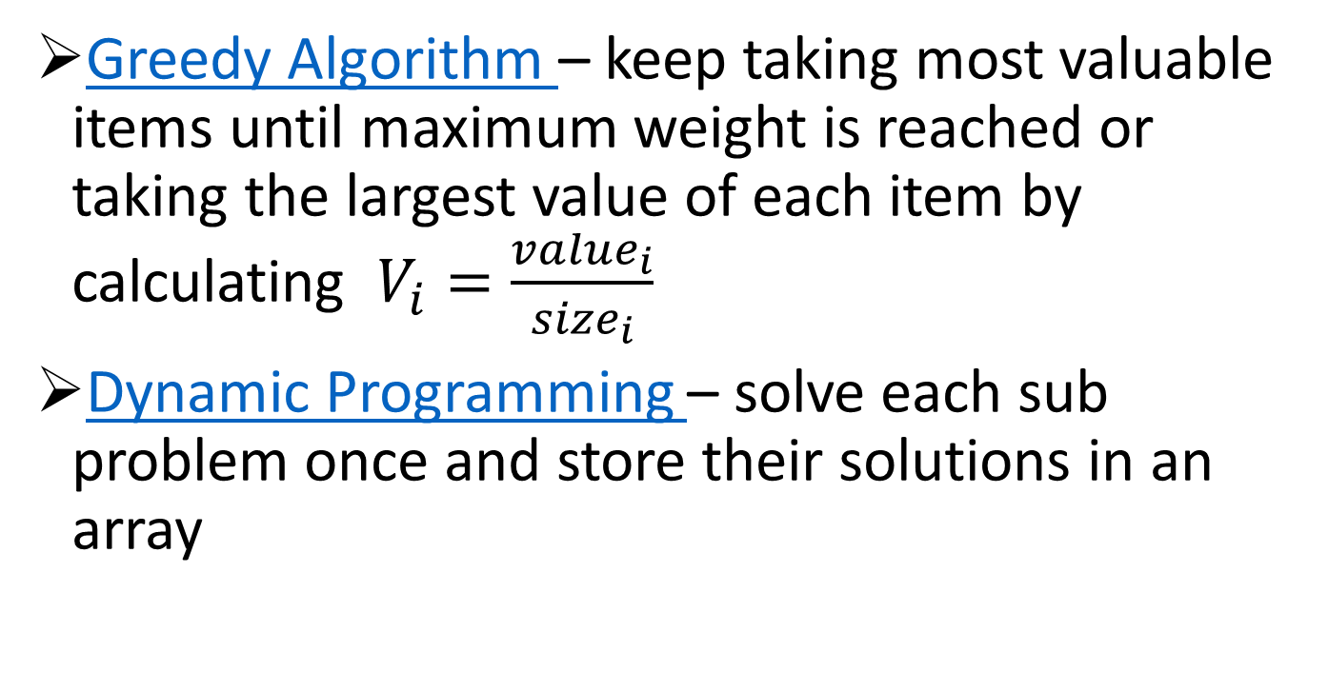
Solutions to Knapsack Problems
Greedy Algorithm – keep taking most valuable items until maximum weight is reached or taking the largest value of each item by calculating $V_{i}=\frac{{value}_{i}}{{size}_{i}}$
Dynamic Programming – solve each sub problem once and store their solutions in an array

Slide 9
Points to Remember
In this problem we have a knapsack that has a weight limit W.
There are items i_{1,}i _{2,} ……i_{n} each having weight w₁,w₂…..w_{n} and some benefit(value or profit) associated with it v_{1,} v₂ ,…….v_{n.}
Our objective is to maximize the benefit such that the total weight inside the knapsack is at most W.
And we are also allowed to take an item in fractional part.

Slide 10
Assume that we have a knapsack with max weight capacity
W=16
Our objective is to fill the knapsack with items such that the(value or profit) is maximum.

Slide 11
Consider the following items and their associated weight and value. W=16
ITEM | WEIGHT | VALUE
i₁ | 6 | 6
i₂ | 10 | 2
i₃ | 3 | 1
i₄ | 5 | 8
i₅ | 1 | 3
i₆ | 3 | 5

Slide 12
Steps
Calculate value per weight for each item(we can call this value density).
Sort the items as per the value density in descending order.
Take as much as possible not already taken in the knapsack.

Slide 13
Calculate density W=16
ITEM | WEIGHT | VALUE | DENSITY
i₁ | 6 | 6 | 1.00
i₂ | 10 | 2 | 0.200
i₃ | 3 | 1 | 0.333
i₄ | 5 | 8 | 1.600
i₅ | 1 | 3 | 3.000
i₆ | 3 | 5 | 1.667

Slide 14
Now we will pick items such that our benefit is maximum and total weight of the selected items is at most W. W=16
ITEN | WEIGHT | VALUE | DENSITY
i₅ | 1 | 3 | 3.000
i₆ | 3 | 5 | 1.667
i₄ | 5 | 8 | 1.600
i₁ | 6 | 6 | 1.000
i₃ | 3 | 1 | 0.333
i₂ | 10 | 2 | 0.200

Slide 15
Now we draw another table to represent knapsack. Our objective is to fill the knapsack with items to get maximum benefit without crossing weight limit W=16. Knapsack
ITEN | WEIGHT | VALUE | DENSITY
i₅ | 1 | 3 | 3.000
i₆ | 3 | 5 | 1.667
i₄ | 5 | 8 | 1.600
i₁ | 6 | 6 | 1.000
i₃ | 3 | 1 | 0.333
i₂ | 10 | 2 | 0.200
ITEM | WEIGHT | VALUE | TOTAL WEIGHT | BENIFIT

Slide 16
W=16 check i₅ is WEIGHT(i₅)+TOTAL WEIGHT<=W Total weight inside 1+0<=16 knapsack is 0 1<=16 YES So we take the whole item. Knapsack
ITEN | WEIGHT | VALUE | DENSITY
i₅ | 1 | 3 | 3.000
i₆ | 3 | 5 | 1.667
i₄ | 5 | 8 | 1.600
i₁ | 6 | 6 | 1.000
i₃ | 3 | 1 | 0.333
i₂ | 10 | 2 | 0.200
ITEM | WEIGHT | VALUE | TOTAL WEIGH | BENIFIT
i₅ | 1 | 3 | 1.000 | 3.000

Slide 17
W=16 check i₆ is WEIGHT(i₆)+TOTAL WEIGHT<=W Total weight inside 3+1<=16 knapsack is 1.000 4<=16 YES So we take the whole item. Knapsack
ITEN | WEIGHT | VALUE | DENSITY
i₅ | 1 | 3 | 3.000
i₆ | 3 | 5 | 1.667
i₄ | 5 | 8 | 1.600
i₁ | 6 | 6 | 1.000
i₃ | 3 | 1 | 0.333
i₂ | 10 | 2 | 0.200
ITEM | WEIGHT | VALUE | TOTAL WEIGH | BENIFIT
i₅ | 1 | 3 | 1.000 | 3.000
i₆ | 3 | 5 | 4.000 | 8.000

Slide 18
W=16 check i₄ is WEIGHT(i₄)+TOTAL WEIGHT<=W Total weight inside 5+4<=16 knapsack is 4.000 9<=16 YES So we take the whole item. Knapsack
ITEN | WEIGHT | VALUE | DENSITY
i₅ | 1 | 3 | 3.000
i₆ | 3 | 5 | 1.667
i₄ | 5 | 8 | 1.600
i₁ | 6 | 6 | 1.000
i₃ | 3 | 1 | 0.333
i₂ | 10 | 2 | 0.200
ITEM | WEIGHT | VALUE | TOTAL WEIGH | BENIFIT
i₅ | 1 | 3 | 1.000 | 3.000
i₆ | 3 | 5 | 4.000 | 8.000
i₄ | 5 | 8 | 9.000 | 16.000

Slide 19
W=16 check i₁ is WEIGHT(i₁)+TOTAL WEIGHT<=W Total weight inside 6+9<=16 knapsack is 9.000 15<=16 YES So we take the whole item. Knapsack
ITEN | WEIGHT | VALUE | DENSITY
i₅ | 1 | 3 | 3.000
i₆ | 3 | 5 | 1.667
i₄ | 5 | 8 | 1.600
i₁ | 6 | 6 | 1.000
i₃ | 3 | 1 | 0.333
i₂ | 10 | 2 | 0.200
ITEM | WEIGHT | VALUE | TOTAL WEIGH | BENIFIT
i₅ | 1 | 3 | 1.000 | 3.000
i₆ | 3 | 5 | 4.000 | 8.000
i₄ | 5 | 8 | 9.000 | 16.000
i₁ | 6 | 6 | 15.000 | 22.000

Slide 20
W=16 check i₃ is WEIGHT(i₃)+TOTAL WEIGHT<=W Total weight inside 3+15<=16 knapsack is 15.000 18<=16 NO So we take the fractional part. Knapsack
ITEN | WEIGHT | VALUE | DENSITY
i₅ | 1 | 3 | 3.000
i₆ | 3 | 5 | 1.667
i₄ | 5 | 8 | 1.600
i₁ | 6 | 6 | 1.000
i₃ | 3 | 1 | 0.333
i₂ | 10 | 2 | 0.200
ITEM | WEIGHT | VALUE | TOTAL WEIGH | BENIFIT
i₅ | 1 | 3 | 1.000 | 3.000
i₆ | 3 | 5 | 4.000 | 8.000
i₄ | 5 | 8 | 9.000 | 16.000
i₁ | 6 | 6 | 15.000 | 22.000

Slide 21
We will fill the knapsack with 1 weight of i₃ item having value(1/3=0.333) Knapsack
ITEN | WEIGHT | VALUE | DENSITY
i₅ | 1 | 3 | 3.000
i₆ | 3 | 5 | 1.667
i₄ | 5 | 8 | 1.600
i₁ | 6 | 6 | 1.000
i₃ | 3 | 1 | 0.333
i₂ | 10 | 2 | 0.200
ITEM | WEIGHT | VALUE | TOTAL WEIGH | BENIFIT
i₅ | 1 | 3 | 1.000 | 3.000
i₆ | 3 | 5 | 4.000 | 8.000
i₄ | 5 | 8 | 9.000 | 16.000
i₁ | 6 | 6 | 15.000 | 22.000
i₃ | 1 | 0.333 | 16.000 | 22.333

Slide 22
W=16 Total weight inside the knapsack is 16 so we stop here TOTAL WEIGHT inside the knapsack is 16.000 Knapsack
ITEN | WEIGHT | VALUE | DENSITY
i₅ | 1 | 3 | 3.000
i₆ | 3 | 5 | 1.667
i₄ | 5 | 8 | 1.600
i₁ | 6 | 6 | 1.000
i₃ | 3 | 1 | 0.333
i₂ | 10 | 2 | 0.200
ITEM | WEIGHT | VALUE | TOTAL WEIGH | BENIFIT
i₅ | 1 | 3 | 1.000 | 3.000
i₆ | 3 | 5 | 4.000 | 8.000
i₄ | 5 | 8 | 9.000 | 16.000
i₁ | 6 | 6 | 15.000 | 22.000
i₃ | 1 | 0.333 | 16.000 | 22.333

Slide 23
So the maximum benefit is 22.333 Knapsack
ITEN | WEIGHT | VALUE | DENSITY
i₅ | 1 | 3 | 3.000
i₆ | 3 | 5 | 1.667
i₄ | 5 | 8 | 1.600
i₁ | 6 | 6 | 1.000
i₃ | 3 | 1 | 0.333
i₂ | 10 | 2 | 0.200
ITEM | WEIGHT | VALUE | TOTAL WEIGH | BENIFIT
i₅ | 1 | 3 | 1.000 | 3.000
i₆ | 3 | 5 | 4.000 | 8.000
i₄ | 5 | 8 | 9.000 | 16.000
i₁ | 6 | 6 | 15.000 | 22.000
i₃ | 1 | 0.333 | 16.000 | 22.333

Slide 24
Greedy Algorithm
The optimal solution to the fractional knapsack
Not an optimal solution to the 0-1 knapsack

Slide 25
Huffman Codes

Slide 26
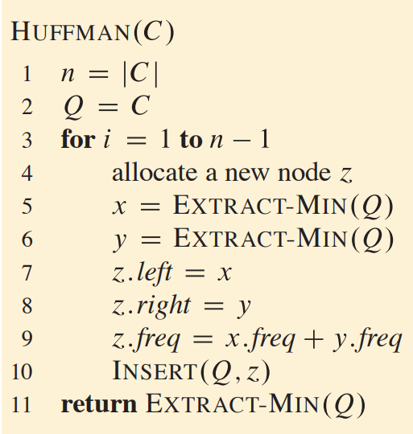
Huffman Codes Algorithm

Slide 27
Huffman Codes
Widely used technique for data compression
Assume the data to be a sequence of characters
Looking for an effective way of storing the data
Binary character code
Uniquely represents a character by a binary string

Slide 28
Fixed-Length Codes
E.g.: Data file containing 100,000 characters
3 bits needed
a = 000, b = 001, c = 010, d = 011, e = 100, f = 101
Requires: 100,000 ⋅ 3 = 300,000 bits
 | a | b | c | d | e | f
Frequency (thousands) | 45 | 13 | 12 | 16 | 9 | 5

Slide 29
Huffman Codes
Idea:
Use the frequencies of occurrence of characters to build a optimal way of representing each character
 | a | b | c | d | e | f
Frequency (thousands) | 45 | 13 | 12 | 16 | 9 | 5

Slide 30
Variable-Length Codes
E.g.: Data file containing 100,000 characters
Assign short codewords to frequent characters and long codewords to infrequent characters
a = 0, b = 101, c = 100, d = 111, e = 1101, f = 1100
(45 ⋅ 1 + 13 ⋅ 3 + 12 ⋅ 3 + 16 ⋅ 3 + 9 ⋅ 4 + 5 ⋅ 4)⋅ 1,000
= 224,000 bits
 | a | b | c | d | e | f
Frequency (thousands) | 45 | 13 | 12 | 16 | 9 | 5

Slide 31
Prefix Codes
Prefix codes:
Codes for which no codeword is also a prefix of some other codeword
Better name would be “prefix-free codes”
We can achieve optimal data compression using prefix codes
We will restrict our attention to prefix codes

Slide 32
Encoding with Binary Character Codes
Encoding
Concatenate the codewords representing each character in the file
E.g.:
a = 0, b = 101, c = 100, d = 111, e = 1101, f = 1100
abc = 0 ⋅ 101 ⋅ 100 = 0101100

Slide 33
Decoding with Binary Character Codes
Prefix codes simplify decoding
No codeword is a prefix of another ⇒ the codeword that begins an encoded file is unambiguous
Approach
Identify the initial codeword
Translate it back to the original character
Repeat the process on the remainder of the file
E.g.:
a = 0, b = 101, c = 100, d = 111, e = 1101, f = 1100
001011101 =
0
⋅ 0
⋅ 101
⋅ 1101
= aabe

Slide 34
Prefix Code Representation
Binary tree whose leaves are the given characters
Binary codeword
the path from the root to the character, where 0 means “go to the left child” and 1 means “go to the right child”
Length of the codeword
Length of the path from root to the character leaf (depth of node)
100
100
0
1
0
1
86
14
a: 45
55
0
1
0
0
1
25
30
58
28
14
0
1
0
1
0
1
0
1
0
1
c: 12
b: 13
14
d: 16
a: 45
b: 13
c: 12
d: 16
e: 9
f: 5
0
1
f: 5
e: 9

Slide 35
Optimal Codes
An optimal code is always represented by a full binary tree
Every non-leaf has two children
Fixed-length code is not optimal, variable-length is
How many bits are required to encode a file?
Let C be the alphabet of characters
Let f(c) be the frequency of character c
Let d_{T}(c) be the depth of c’s leaf in the tree T corresponding to a prefix code
the cost of tree T

Slide 36
Constructing a Huffman Code
A greedy algorithm that constructs an optimal prefix code called a Huffman code
Assume that:
C is a set of n characters
Each character has a frequency f(c)
The tree T is built in a bottom up manner
Idea:
Start with a set of |C| leaves
At each step, merge the two least frequent objects: the frequency of the new node = sum of two frequencies
Use a min-priority queue Q, keyed on f to identify the two least frequent objects
f: 5
e: 9
c: 12
b: 13
d: 16
a: 45

Slide 37
Example
f: 5
e: 9
c: 12
b: 13
d: 16
a: 45
c: 12
b: 13
14
d: 16
a: 45
0
1
f: 5
e: 9
14
d: 16
25
a: 45
25
30
a: 45
0
1
0
1
0
1
0
1
f: 5
e: 9
c: 12
b: 13
c: 12
b: 13
14
d: 16
0
1
f: 5
e: 9
55
0
100
1
a: 45
0
1
a: 45
55
25
30
0
1
0
1
0
1
25
30
c: 12
b: 13
14
d: 16
0
1
0
1
0
1
c: 12
b: 13
14
d: 16
f: 5
e: 9
0
1
f: 5
e: 9

Slide 38
Textbooks & Web References
Text Book (Chapter 16)
Reference book iii (Chapter 17)
www.geeksforgeeks.org
www.codeforces.com

Slide 39
Thank you
&
Any question?

